Slide 1
Assembly Bible Classes for Teens
YEAR 2017
Feasts of Jehovah (Lev 23).
Class No 1

Slide 2
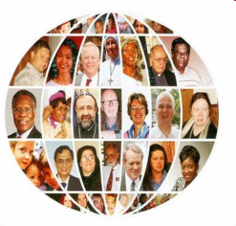
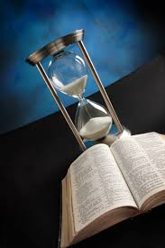
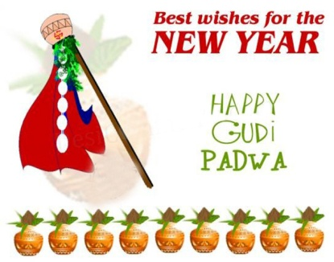
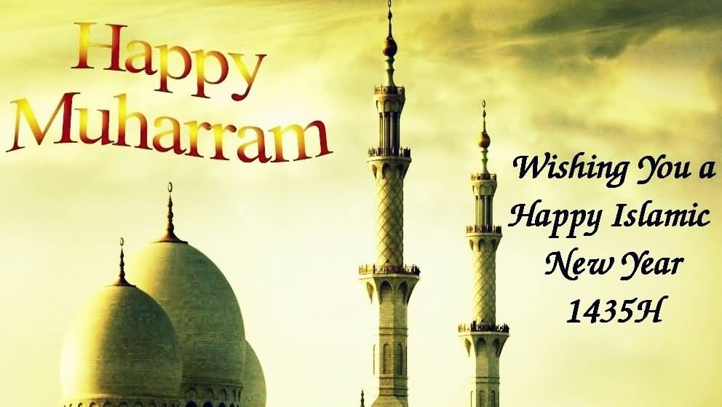
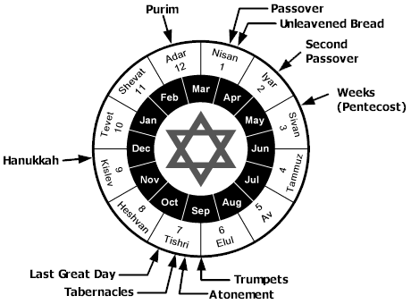
I) INTRODUCTION Feasts of Jehovah
People around the globe have different calendar and they function accordingly
Similarly, our calendar and God’s calendar is also totally different
God works as per His calendar not as per our
The seven feasts of Jehovah is God’s calendar
This calendar (feasts) is primarily for Israel, from their release to their rest
But this calendar (feasts) is also for all humanity, man’s salvation to man’s eternal rest.

Slide 3
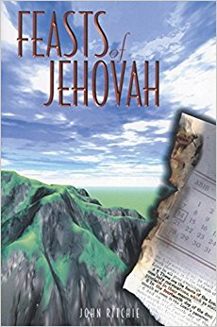
I) INTRODUCTION Feasts of Jehovah
These are Jehovah’s feast NOT Jews’ feast
Lev 23.2 Speak unto the children of Israel, and say unto them, Concerning the feasts of the LORD, which ye shall proclaim to be holy convocations, even these are my feasts
holy convocations
holy convocations
Lev 23.4 These are the feasts of the LORD, ...
Jehovah’s feasts means, His divine appointment, a particular time which is fixed by Jehovah Himself
The word “holy convocation” have occurred 11 times in Lev 23 (vs 2,3,4,7,8,21,24,27,35,36,37)
Holy convocation means to meet someone by appointment
For e.g. in garden of Eden God used to meet Adam & Eve, but here God is asking His people to meet Him.

Slide 4
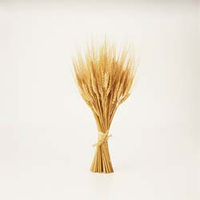
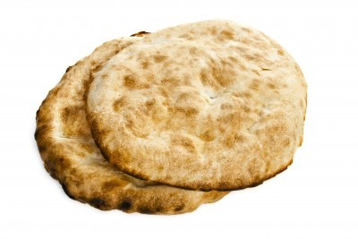
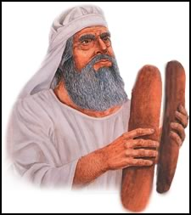
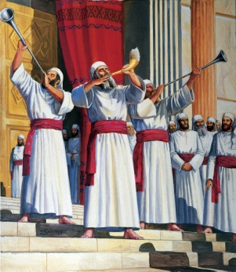
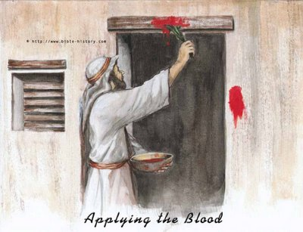
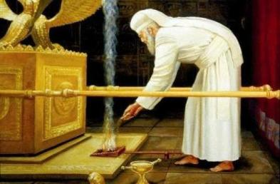
I) INTRODUCTION Feasts of Jehovah
Seven Feasts
Feasts of Jehovah (as per Lev 23)
1. The feast of Passover
Lev 23.5
2. The feast of Unleavened bread
Lev 23.6-8
3. The feast of Firstfruits
Lev 23.9-14
4. The feast of Pentecost
Lev 23.15-16
5. The feast of Trumpets
Lev 23.23-25
6. The day of Atonement
Lev 23.26-32
7. The feast of Tabernacles
Lev 23.33-43
It is not essential for believers to celebrate these feasts days literally, but it is certainly beneficial to study them.

Slide 5
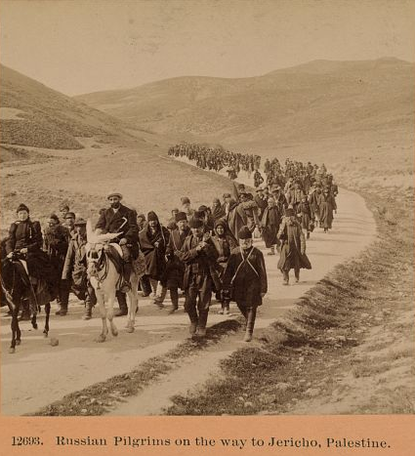
I) INTRODUCTION Facts of these Feasts
1. Feast of Passover
2. Feast of unleavened bread
3. Feast of firstfruits
1. Feast of Passover
4. Feast of Pentecost
4. Feast of Pentecost
5. Feast of Trumpets
6. The day of Atonement
7. Feast of Tabernacles
7. Feast of Tabernacles
1. Some of these feasts were called as Pilgrimage Feasts
i) Pilgrimage feasts speaks about different advents (coming)
Feast of Passover
speaks about Christ’s 1st coming
Feast of Pentecost
speaks about coming of the Holy Spirit
Feast of Tabernacles
speaks about Christ’s 2nd coming (for Israel)
ii) Pilgrimage feasts speaks about different characters of LJC
Feast of Passover
Lord Jesus is the Sufferer
His past ministry
Feast of Pentecost
He is the Sympathizer
His present ministry
Feast of Tabernacles
He is the Sovereign
His future ministry.

Slide 6
I) INTRODUCTION Facts of these Feasts
1. Feast of Passover
2. Feast of unleavened bread
3. Feast of firstfruits
1. Feast of Passover
2. Feast of unleavened bread
3. Feast of firstfruits
4. Feast of Pentecost
4. Feast of Pentecost
5. Feast of Trumpets
6. The day of Atonement
5. Feast of Trumpets
6. The day of Atonement
7. Feast of Tabernacles
7. Feast of Tabernacles
2. These feasts were celebrated in different months
1st, 2nd and 3rd feast were celebrated in first month (Nisan/Abib month)
4th feast were celebrated in third month (Sivan month)
5th, 6th and 7th feast were celebrated in 7th month (Tishri/Ethanim month).

Slide 7
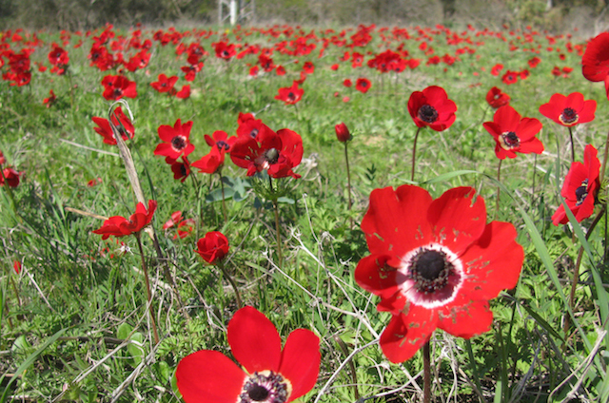
I) INTRODUCTION Facts of these Feasts
1. Feast of Passover
2. Feast of unleavened bread
3. Feast of firstfruits
1. Feast of Passover
2. Feast of unleavened bread
3. Feast of firstfruits
4. Feast of Pentecost
4. Feast of Pentecost
5. Feast of Trumpets
6. The day of Atonement
5. Feast of Trumpets
6. The day of Atonement
7. Feast of Tabernacles
7. Feast of Tabernacles
3. These feasts were celebrated in different seasons
Spring and Autumn are the two main seasons in Israel
First four feasts occurred during the Spring of the year
These 4 feasts speak about the life, work, death & resurrection of LJC
Spring
Autumn
These four feasts are fulfilled in the 1st coming of LJC
Last three feasts occurred during the Autumn of the year
Last three feasts will be fulfilled after the 2nd coming of LJC
As the first four feasts were fulfilled, similarly the remaining feasts will also be fulfilled soon.

Slide 8
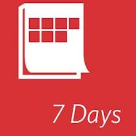
I) INTRODUCTION Facts of these Feasts
1. Feast of Passover
2. Feast of unleavened bread
3. Feast of firstfruits
1. Feast of Passover
2. Feast of unleavened bread
3. Feast of firstfruits
4. Feast of Pentecost
4. Feast of Pentecost
5. Feast of Trumpets
6. The day of Atonement
5. Feast of Trumpets
6. The day of Atonement
7. Feast of Tabernacles
7. Feast of Tabernacles
4. These feasts were for limited days
Five feasts were one day feasts, they are…
One day feast shows that this incident have happened only once in history. There is no repetition of such incident in future
For example, the death of Lord Jesus, the resurrection, the coming of the Holy spirit on the day of Pentecost
One day feast also shows that this incident is and will be for a short time
Remaining two feasts were seven days feast, they are…
Seven days feast shows that this incident will be for a long time.

Slide 9
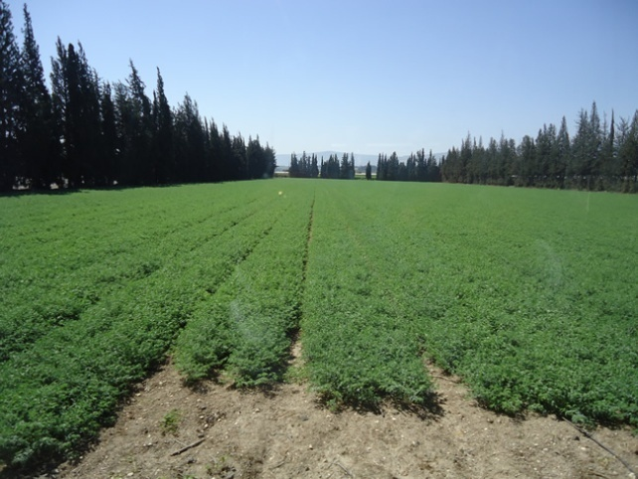
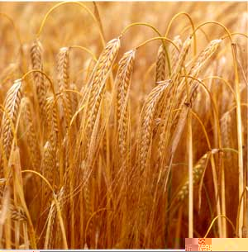
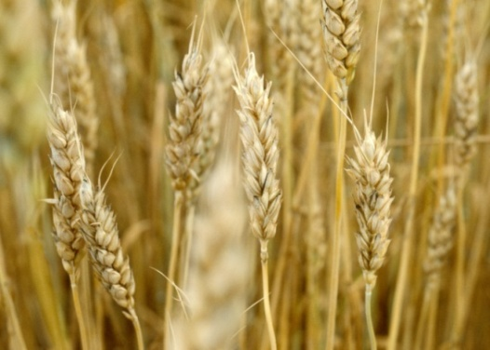
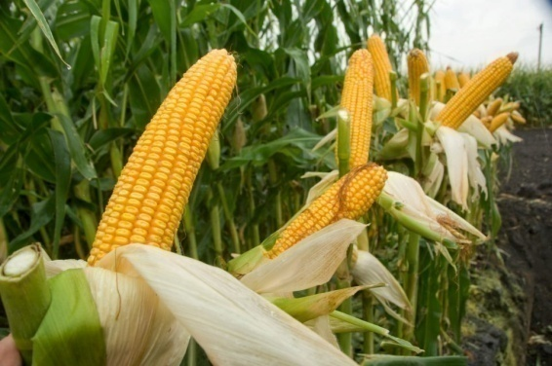
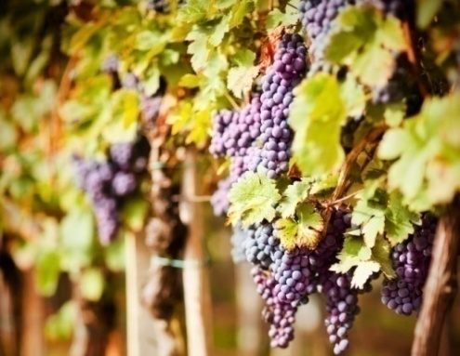
I) INTRODUCTION Facts of these Feasts
1. Feast of Passover
2. Feast of unleavened bread
3. Feast of firstfruits
3. Feast of firstfruits
4. Feast of Pentecost
4. Feast of Pentecost
5. Feast of Trumpets
6. The day of Atonement
7. Feast of Tabernacles
7. Feast of Tabernacles
5. These were Agricultural feasts
The feast of Firstfruits, was celebrated during barley harvest
The feast of Pentecost, was celebrated during wheat harvest
The feast of Tabernacles, was celebrated during corn and wine harvest (Deut 16.13).

Slide 10
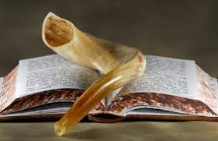
I) INTRODUCTION Facts of these Feasts
1. Feast of Passover
2. Feast of unleavened bread
3. Feast of firstfruits
4. Feast of Pentecost
5. Feast of Trumpets
6. The day of Atonement
7. Feast of Tabernacles
6. These were Memorial feasts
Exo 12.14 And this day shall be unto you for a memorial; and ye shall keep it a feast to the LORD throughout your generations…
Exo 13.3 And Moses said unto the people, Remember this day, in which ye came out from Egypt, out of the house of bondage…
Deut 16.12 And thou shalt remember that thou wast a bondman in Egypt: and thou shalt observe and do these statutes
We remember our Birthday, Independence day etc
Likewise through these feasts, God wants them to remember who and how they were.

Slide 11
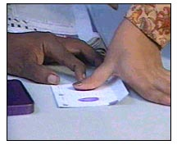
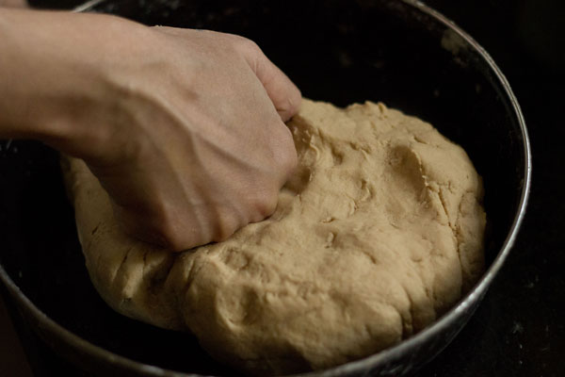
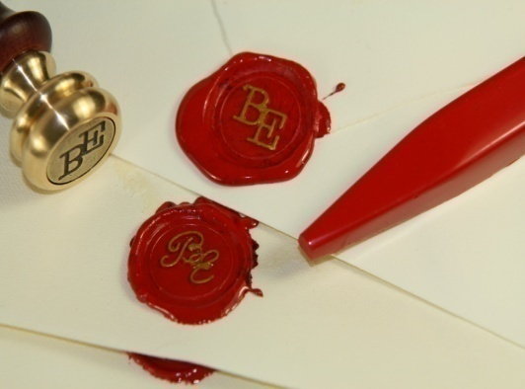
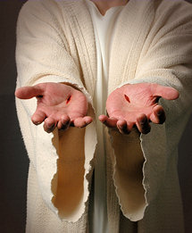
I) INTRODUCTION Facts of these Feasts
7. These were Prophetic feasts
1 Cor 10.11 Now all these things happened unto them for ensamples (Tupos)
Tupos means type. To make an impression (mark) by applying pressure. N
Like impression of thump on a paper
Like impression of fingers while mixing the dough
Like impression of wax (seal) on govt. papers
Like impression of nails, on the hands of Lord Jesus Christ. MJ
God loves His son so much that He has made His Son’s impression (Tupos) everywhere in Bible (John 5.46, Lk 24.27,44)
Lk 24.27 And beginning at Moses and all the prophets, he expounded unto them in all the scriptures the things concerning himself
Lk 24.44 …that all things must be fulfilled, which were written in the law of Moses, and in the prophets, and in the psalms, concerning me
Feasts of Jehovah are also tupos of LJC in many ways.

Slide 12
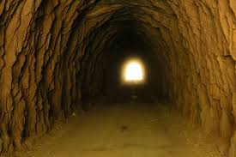
7. These were Prophetic feasts
Have you ever travelled . through tunnel?
These feasts are similar to that light in the tunnel
1. The feast of Passover
5. The feast of Trumpets
2. The feast of Unleavened bread
6. The day of Atonement
3. The feast of firstfruits
7. The feast of Tabernacles**
4. The feast of Pentecost

